Slide 1
Module 2 Learning Set Of Rules
Raghu Prasad K S
9845547471

Slide 2
Learning Sets of Rules
📚 Learning Sets of Rules
The concept of "Learning Sets of Rules" is a core area in Machine Learning (ML), particularly within the field of Rule-Based Classification. The goal is to induce human-readable, symbolic classification knowledge in the form of IF-THEN rules.
The general approach is called Sequential Covering or Separate-and-Conquer. The algorithm learns one rule at a time, removes the examples covered by that rule, and repeats the process until all (or most) training examples are covered.

Slide 3
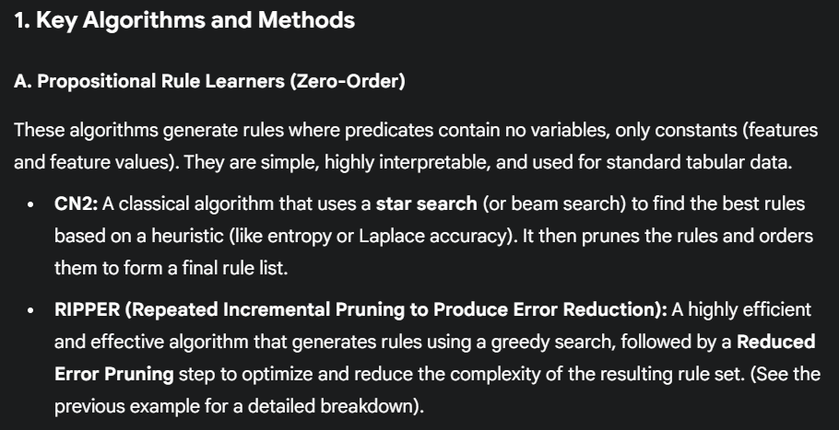
Learning Sets of Rules

Slide 4
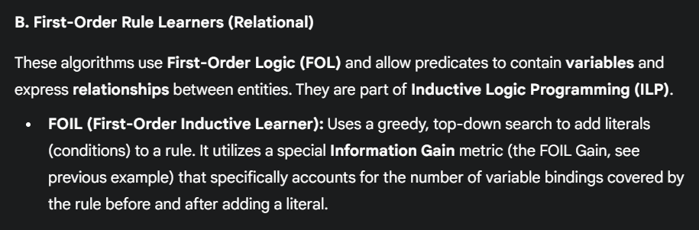
Learning Sets of Rules

Slide 5
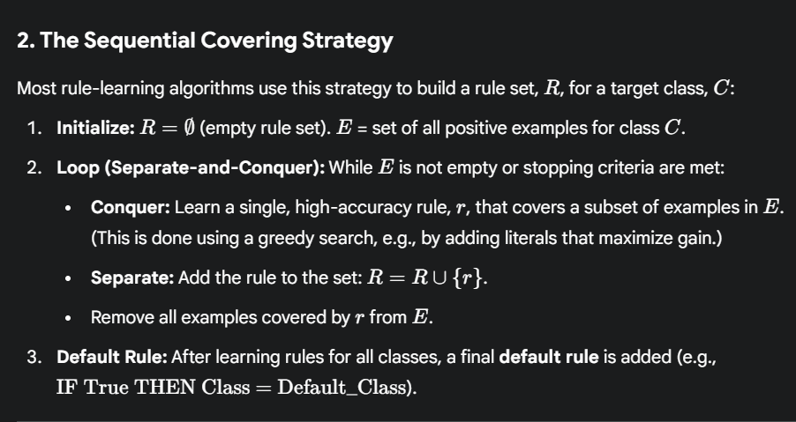
Learning Sets of Rules

Slide 6
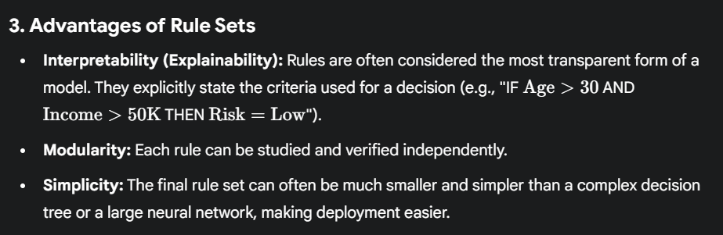
Learning Sets of Rules

Slide 7
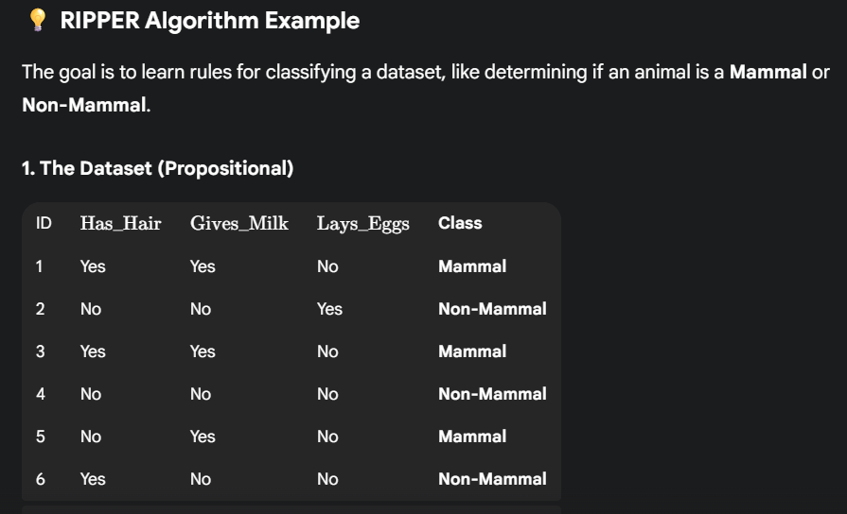
Learning Sets of Rules

Slide 8
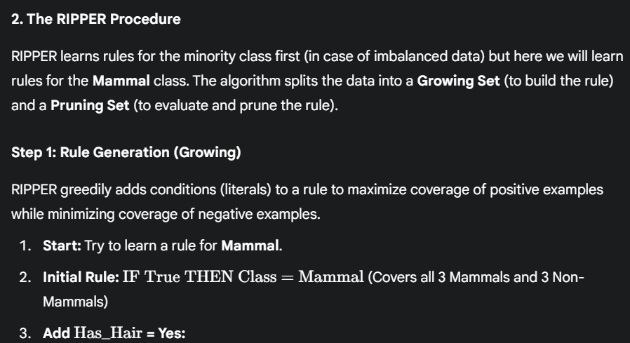
Learning Sets of Rules

Slide 9
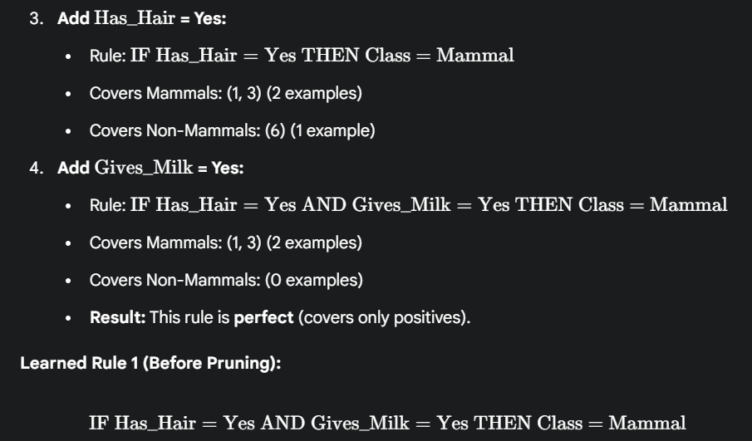
Learning Sets of Rules

Slide 10
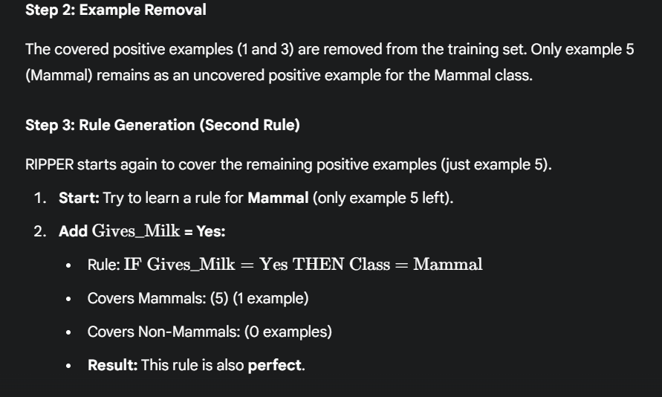
Learning Sets of Rules

Slide 11
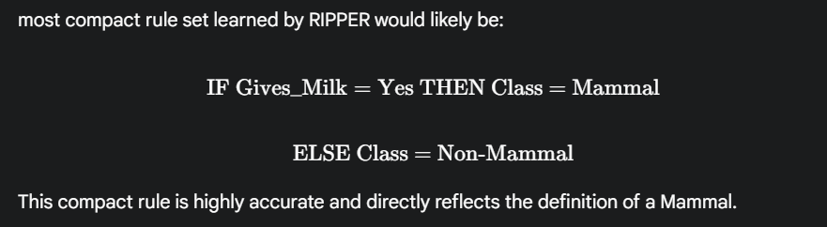
Learning Sets of Rules

Slide 12
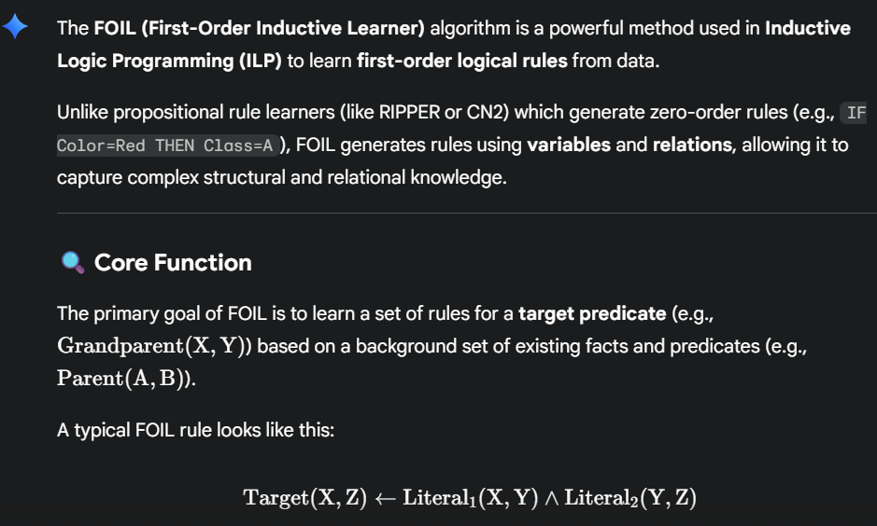
Learning Sets of Rules-FOIL

Slide 13
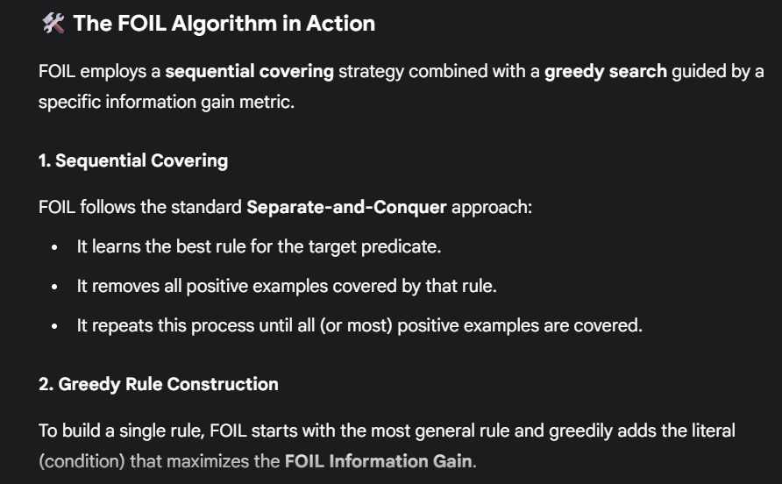
Learning Sets of Rules-FOIL

Slide 14
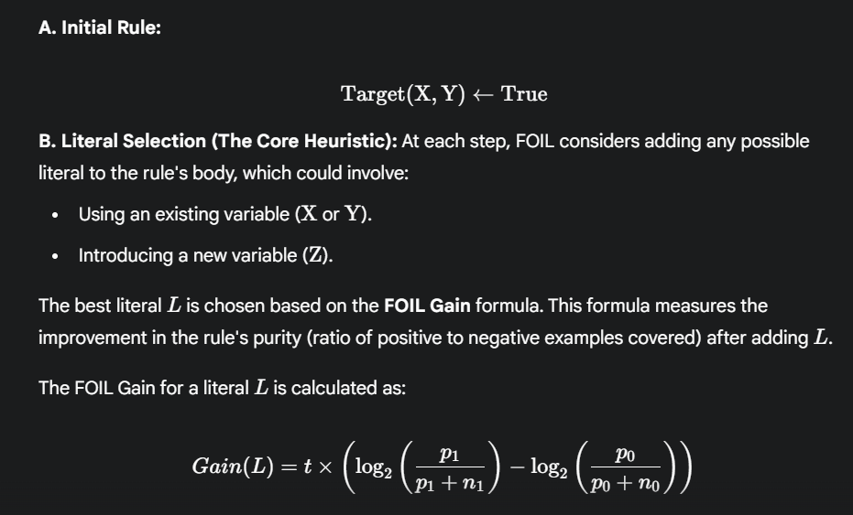
Learning Sets of Rules-FOIL

Slide 15
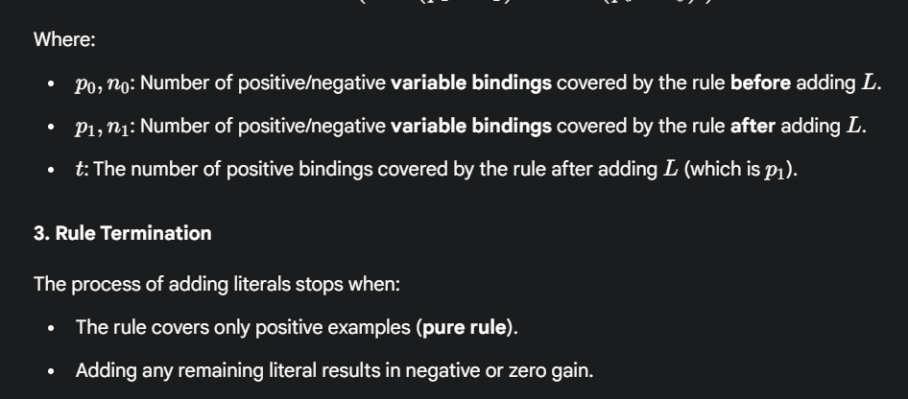
Learning Sets of Rules-FOIL

Slide 16
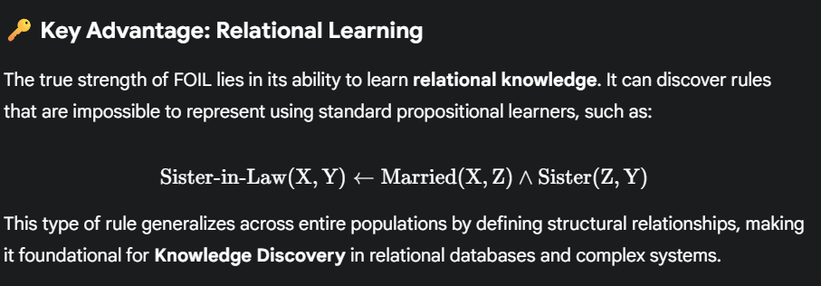
Learning Sets of Rules-FOIL

Slide 17
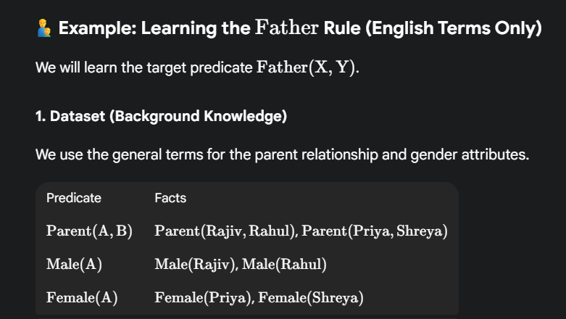
Learning Sets of Rules-FOIL

Slide 18
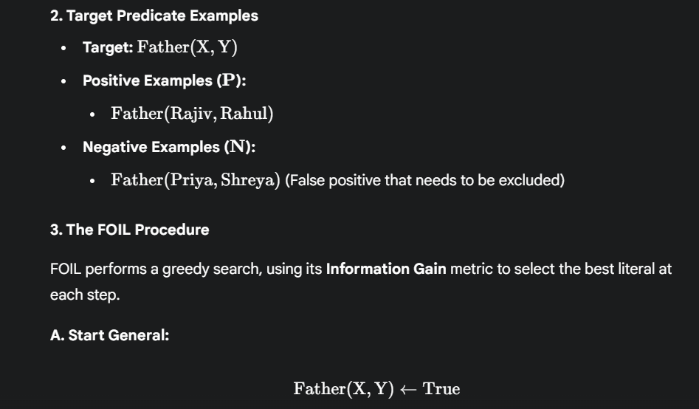
Learning Sets of Rules-FOIL

Slide 19
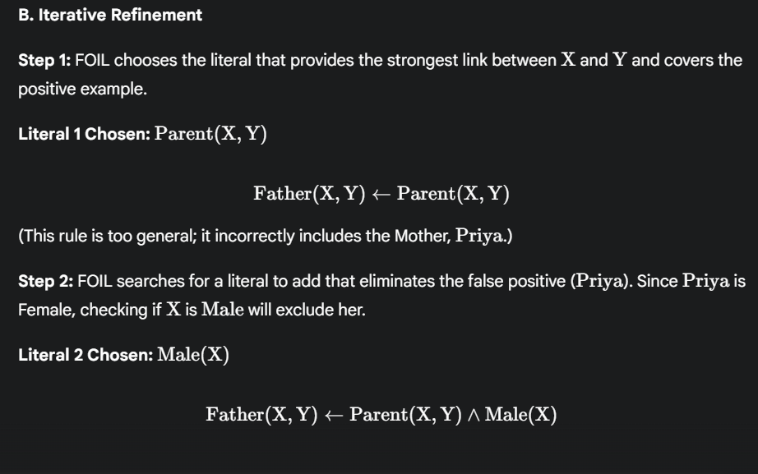
Learning Sets of Rules-FOIL

Slide 20
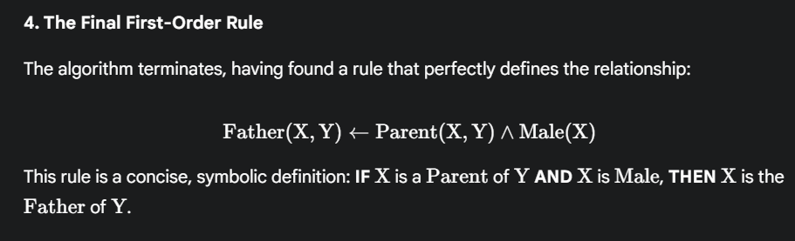
Learning Sets of Rules-FOIL

